Slide 1
JavaScript Events

Slide 2
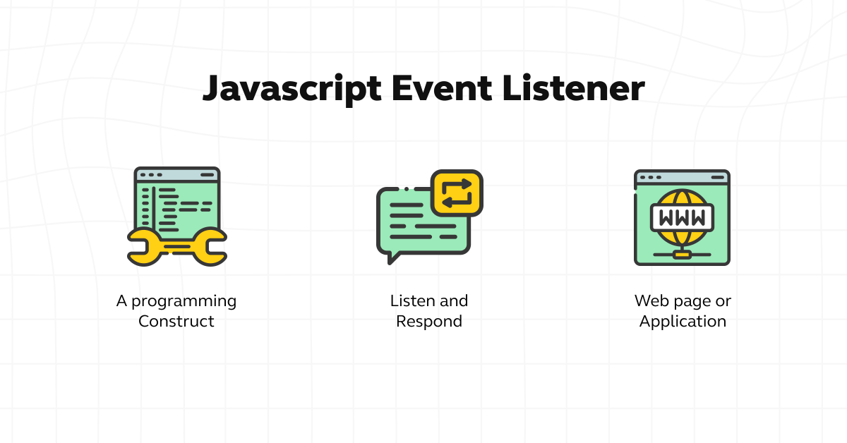
What is a JavaScript Event?
Definition: A JavaScript event is a specific action that occurs within a web page or application, such as clicking on an element, moving the mouse, pressing a key, or loading a page.
Essentially, events are like signals that tell the browser to execute certain code or perform specific actions in response to user interactions or other occurrences.
When an event occurs, it is handled by event listeners or event handlers, which are functions specifically written to respond to particular events.

Slide 3
How events work in JavaScript
1. Event Triggering: Events can be triggered by user interactions (like clicking, hovering, typing) or by the browser itself (like when a page finishes loading).
2. Event Handling: To respond to these events, developers write event handler functions. These functions contain the instructions or code that should run when the event occurs.
3. Event Binding: Event handlers are then bound or attached to specific elements or objects on the webpage using JavaScript methods like addEventListener() or by directly assigning functions to event attributes in HTML.
4. Event Execution: When the specified event occurs, the associated event handler function is executed, allowing the webpage to respond dynamically to user actions or other events.

Slide 4
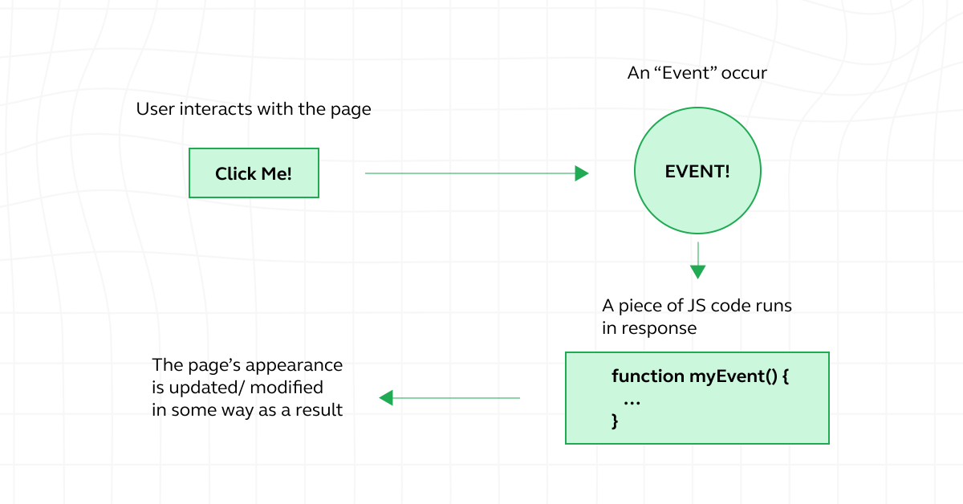
How events work in JavaScript

Slide 5
How to Create an Event in JavaScript?
1. Event Initialization: Begin by initializing a new event object using the Event() constructor. This object represents the custom event you want to create.
2. Event Configuration: Configure the event object by specifying its type. The event type is a descriptive string that identifies the custom event you’re creating. You can also provide additional options, such as whether the event bubbles up through the DOM hierarchy or can be canceled.
3. Dispatching the Event: Once the event object is configured, you can dispatch it to trigger the custom event. Dispatching an event involves specifying the target element or object where the event should originate from and calling the dispatchEvent() method on that target.

Slide 6
How to Create an Event in JavaScript?
Demonstrative Code Examples for Clarity
// Step 1: Event Initialization
var customEvent = new Event(‘customEvent’);
// Step 2: Event Configuration
// You can also pass additional options as the second argument, such as { bubbles: true, cancelable: true }
customEvent.initEvent(‘customEventType’, true, true);
// Step 3: Dispatching the Event
var targetElement = document.getElementById(‘targetElement’);
targetElement.dispatchEvent(customEvent);
Explanation:
=> We first initialize a new event object named customEvent using the Event() constructor.
=> Then, we configure the event object by calling the initEvent() method, specifying the event type (‘customEventType’) and additional options (e.g., whether the event bubbles and is cancelable).
=> Finally, we dispatch the custom event on a target element with the ID ‘targetElement’ using the dispatchEvent() method.

Slide 7
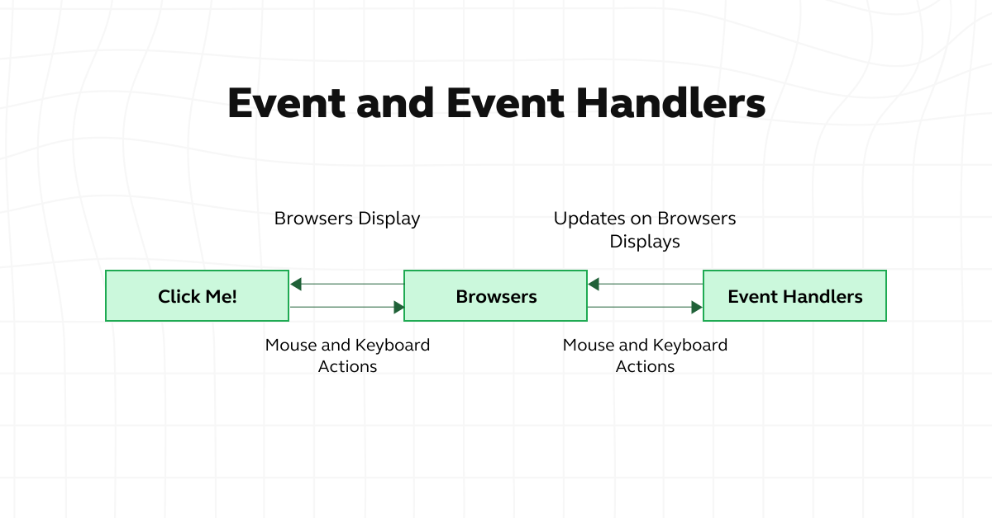
How to Create an Event in JavaScript?

Slide 8
Types of Events in JavaScript
The various types of events in JavaScript are as follows:
A. Onclick Event
The onclick event occurs when a user clicks on an HTML element. It’s one of the most commonly used events in JavaScript.
Example:
<button onclick=”alert(‘Button clicked!’)”>Click me</button>
B. Onekeyup Event
The onekeyup event triggers when a user releases a key after pressing it down. It’s useful for capturing user input from keyboard interactions.
Example:
document.getElementById(‘searchInput’).addEventListener(‘keyup’, function(event) {
console.log(‘Key released:’, event.key);
// Perform search operation or other actions based on user input
});

Slide 9
Types of Events in JavaScript
C. Onmouseover Event
The onmouseover event occurs when the mouse pointer moves onto an element, triggering an action.
Example:
<img src=”image.jpg” onmouseover=”showTooltip(‘Hover over me!’)” onmouseout=”hideTooltip()”>
D. Onload Event
The onload event is fired when a web page or an element has finished loading completely.
Example:
window.onload = function() {
console.log(‘Page loaded’);
// Initialize page content or perform other actions
};
E. Onfocus Event
The onfocus event is triggered when an element gains focus, typically through user interaction like tabbing or clicking.
Example:
<input type=”text” onfocus=”this.style.backgroundColor=’lightblue'” onblur=”this.style.backgroundColor=’white'”>

Slide 10
JavaScript Event Phases
1. Event Capturing
2. Event Targeting
3. Event Bubbling

Slide 11
1. Event Capturing
Definition: Event capturing is the first phase in the event flow process where the event is captured or detected at the highest level of the DOM hierarchy and then propagates down to the target element.
Event capturing allows developers to intercept events before they reach their target, enabling global event handling and delegation.
Practical use cases include implementing event delegation, validating user input, and applying consistent event handling across multiple elements.

Slide 12
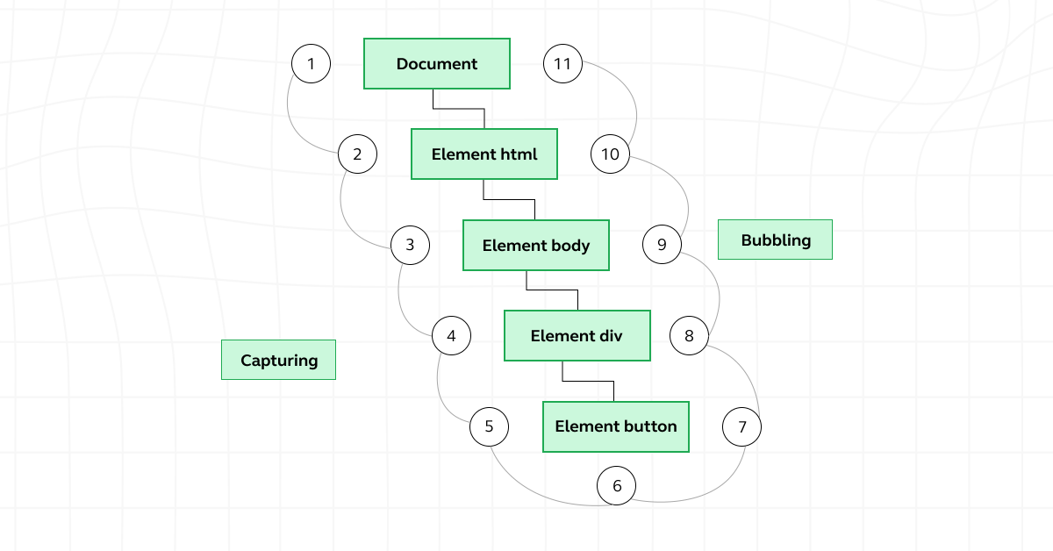
1. Event Capturing

Slide 13
2. Event Targeting
Definition: Event targeting, also known as the “at target” phase, occurs when the event reaches the target element that triggered it.
During the targeting phase, event handlers attached directly to the target element are executed, allowing for specific actions or behaviors to be applied based on the event.

Slide 14
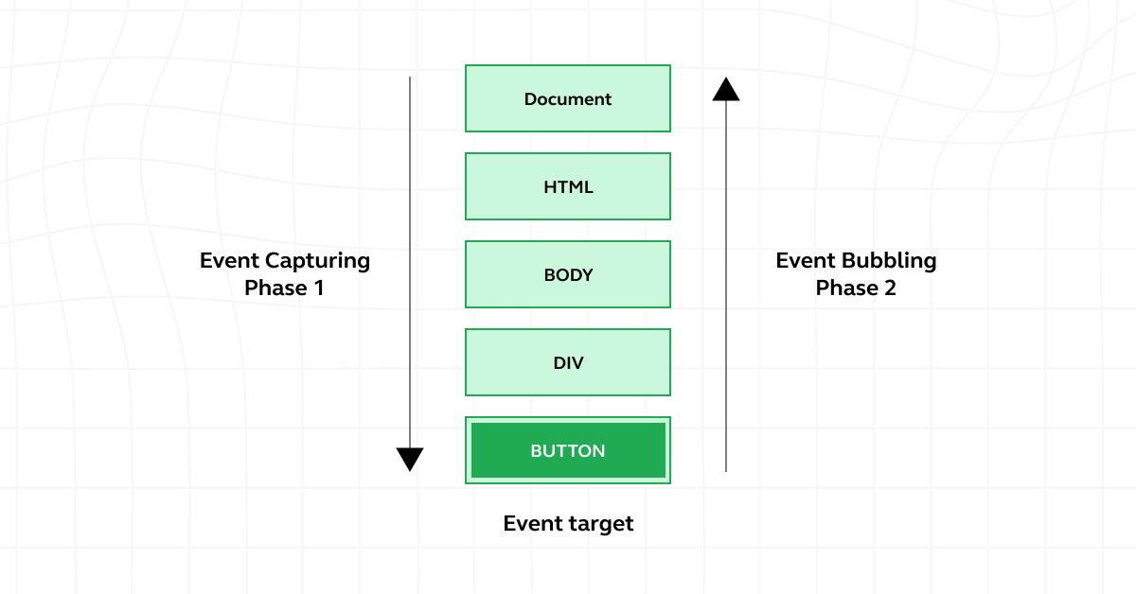
2. Event Targeting

Slide 15
3. Event Bubbling
Definition: Event bubbling is the final phase in the event flow process where the event, having been processed at the target element, propagates back up through the DOM hierarchy to the root element.
Unlike event capturing, which starts from the top of the DOM tree and moves downward, event bubbling starts at the target element and moves upward.
Practical implications include simplifying event handling by allowing for more concise code, enabling event delegation, and facilitating the creation of interactive components.

Slide 16
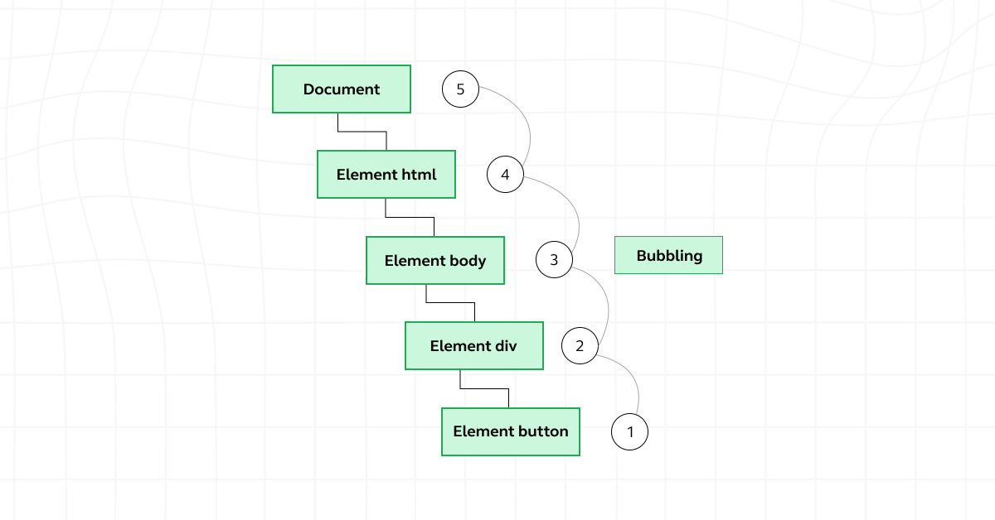
3. Event Bubbling

Slide 17


Slide 18
3. Event Bubbling
Definition: Event bubbling is the final phase in the event flow process where the event, having been processed at the target element, propagates back up through the DOM hierarchy to the root element.
Unlike event capturing, which starts from the top of the DOM tree and moves downward, event bubbling starts at the target element and moves upward.
Practical implications include simplifying event handling by allowing for more concise code, enabling event delegation, and facilitating the creation of interactive components.

